Slide 1
Intro To ML
Course Code - CS422

Slide 2
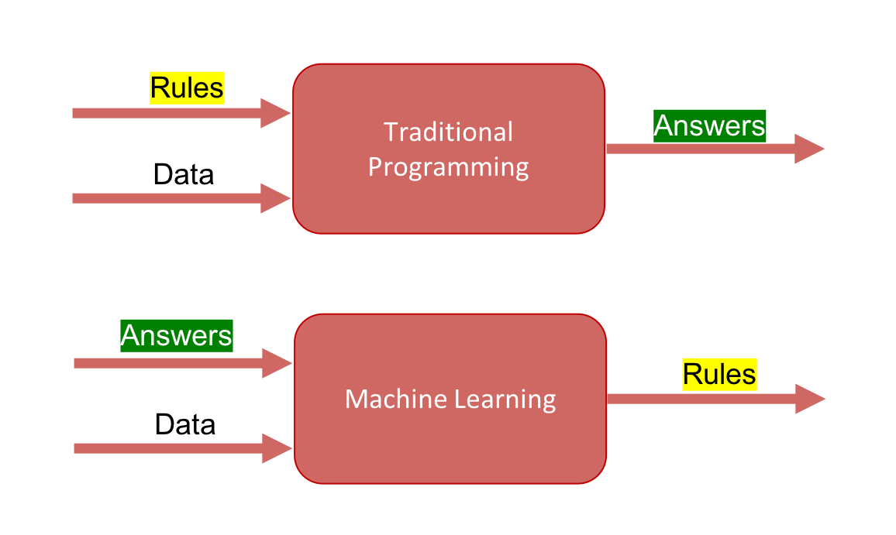
Traditional Learning vs Machine Learning

Slide 3
Our Dataset
Features → CGPA Target Label → Good / Average Students

Slide 4
Traditional Machine
If the CGPA is lower than a threshold, then the output is average student.
Else, then the output is good student.
threshold = rule

Slide 5
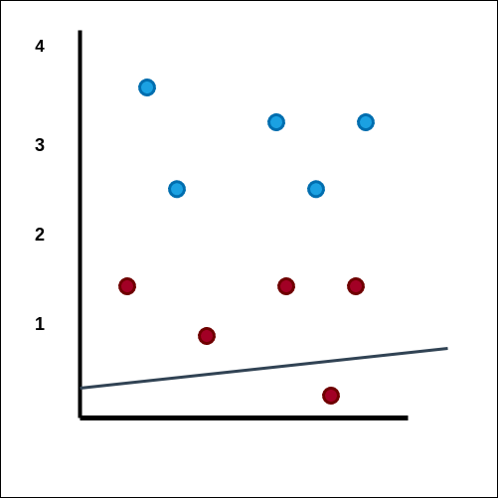
Training Phase Starts
Goal - The line (is the rule) which separates the two labels (good and average) students
Blue - Good Students Red - Average Students
Formulae of a straight line: Y = mx + b .

Slide 6
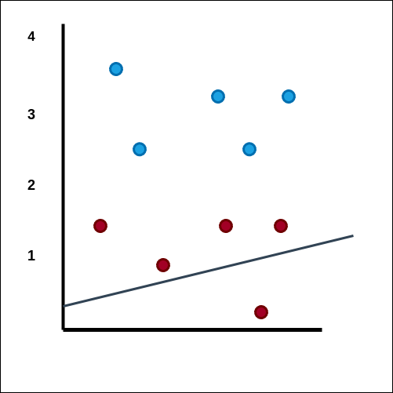
m slightly changed.
Count the number of errors

Slide 7
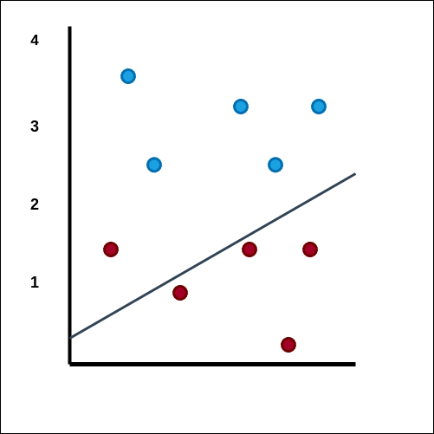

Slide 8
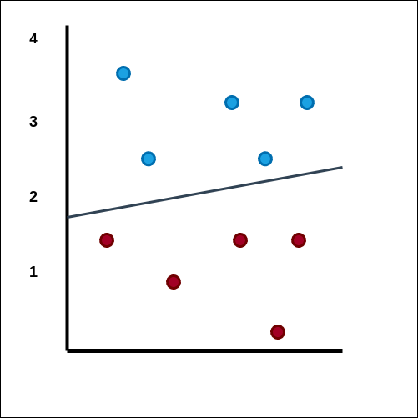

Slide 9
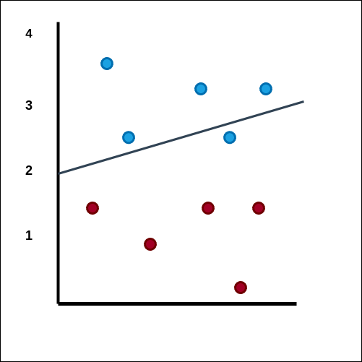

Slide 10
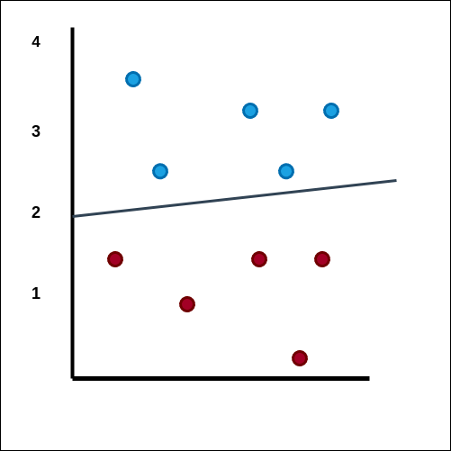
Here, value of m and c changed from the initial value so that our line splits the different labels into two different groups.
Training COMPLETE

Slide 11
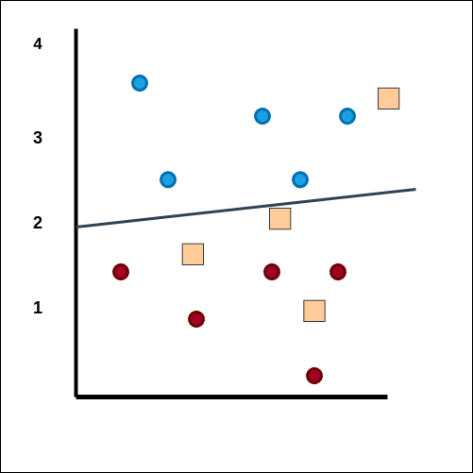
Testing Phase Begins
Above the line - Blue
Below the line - Red

Slide 12
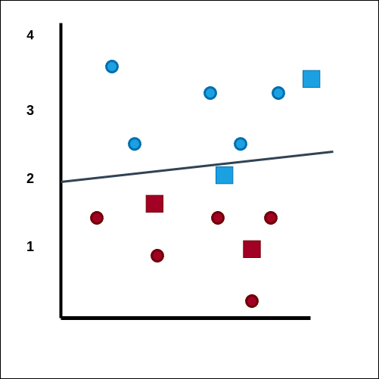
Calculate the accuracy.

Slide 13
Why do we need preprocessing
Raw data has many issues such as null values.
Textual Data that machines can not understand
Not scaled data
After PREPROCESSING, we feed this data to the model to train - test

Slide 14
Train vs Test Phase
Train the model to learn the parameters
Test with unseen data to measure performance of the model

Slide 15
Types of machine Learning
Supervised Learning
Unsupervised Learning

Slide 16
Supervised Learning
Classification
Regression

Slide 17
Classification
Binary (Two classes). Eg - True or False, Yes or No.
Multi Classification (More than two classes).
Eg - Best, Average or Bad. Large, Medium or Small.

Slide 18
Machine Learning
Supervised
Unsupervised
Classification
Regression
Binary
Multi-Class

Slide 19
Input vs Output
Input - Feature Variables
Output - Target variables / Target Labels

Slide 20
Different types of dataset
Tabular Dataset
Image (computer vision)
Text or speech related (NLP)

Slide 21
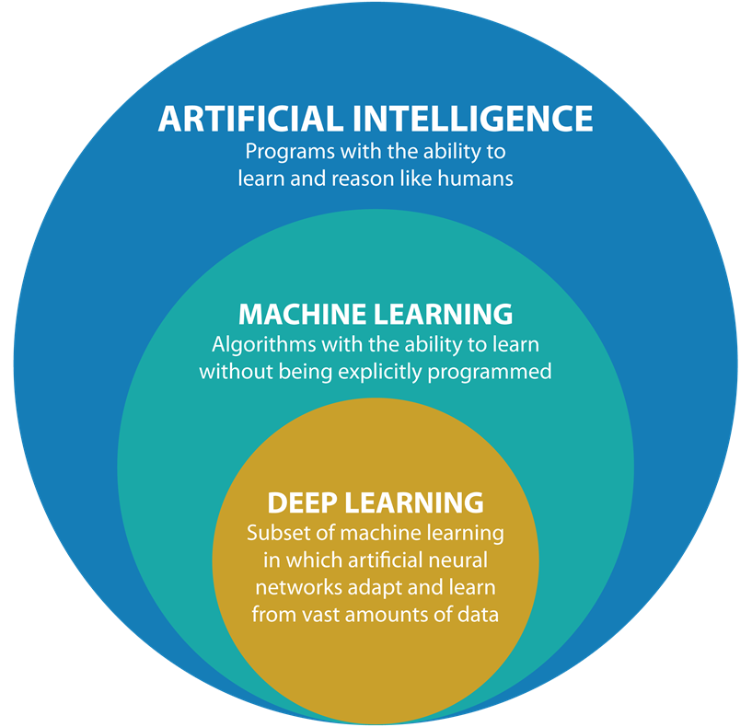

Slide 22
Other types of Machine Learning
Semi supervised Learning
Reinforcement Learning

Slide 23
The End

